Slide 1
Classifying Letters with Neural Networks
Presented By: Alexander Aybar, Tyrell Green, Ishma’il Scott, Talaya Sherdon
Notes:
Talaya

Slide 2





Group Members
Alexander Aybar
Junior
Mechatronics Engineering
Tyrell Green
Sophomore
Electrical Engineering
Ishma’il Scott
Senior
Electrical Engineering
Talaya Sherdon
Sophomore
Industrial Engineering
Notes:
Everyone

Slide 3
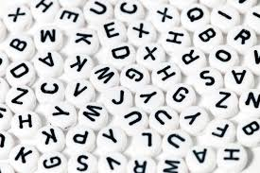
Introduction
Letters are everywhere
Documents
Handwritten letters
Street signs
Notes:
Talaya

Slide 4

Objective
Create a model that can classify handwritten letters in images to convert the physical lettering into data
Notes:
Talaya

Slide 5

Possible Usage
Reads poorly legible characters
Verification
Translator
Handwritten letters
Notes:
Negative Impacts: Misreading information, Not understanding other languages
Purpose in the f

Slide 6

Terminology
Optical Character Recognition(OCR) - Optical character recognition or optical character reader is the electronic or mechanical conversion of images of typed, handwritten or printed text into machine-encoded text
Receiver Operating Characteristic Curve (ROC) - is a graph showing the performance of a classification model at all classification thresholds
Hyperparameters - in machine learning, a hyperparameter is a parameter whose value is used to control the learning process
Naïve Bayes - A family of simple “probabilistic classifiers” based on applying Bayes ‘ theorem with strong independence assumptions between the features.
Confusion Matrix - is a specific table layout that allows visualization of the performance of an algorithm

Slide 7

Phase 1
Analyzing the data
Creating the data frame
Creating the visualizations

Slide 8
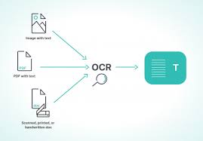
Optical Character Recognition
Identification of printed characters using mechanical/electronic conversion of images into machine-encoded text
This data is filled with binary numbers
Notes:
Contained the train data and test data
No need for exploratory data analysis because data was clean

Slide 9
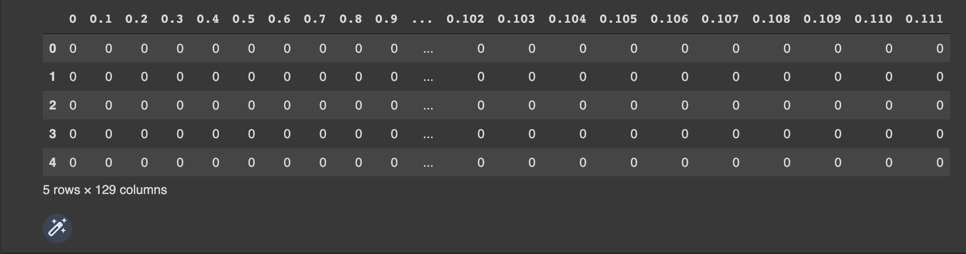
Data Frame
The OCR data (ocr_data.zip) is used to create the data frame
Each row of binary numbers forms a different character when reshaped and plotted

Slide 10
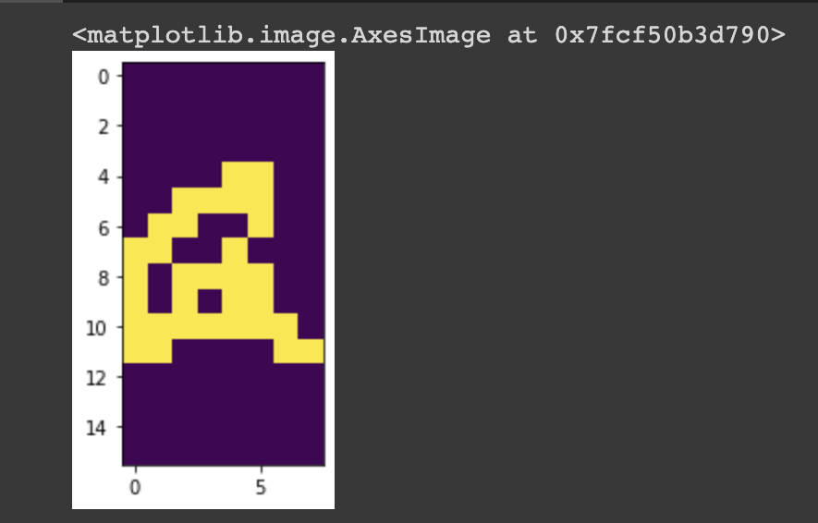
Visualization
Transformed a 1D array into a 2D array to shape an image
Used matplotlib to plot a grayscale image
The image uses binary classification to identify each pixel in the 16 x 8 image
Notes:
NumPy and Matplotlib are libraries
Grayscale -value of each pixel only has only one of two colors
Hard to recognize because it would take too much memory (more pixels=more memory)

Slide 11

Phase 2
Creating our models
Calculate the confusion matrix and display
Notes:
Naïve bayes model; straightforward and fast classification algorithm suited for large chunks of data

Slide 12
Our Models
Naïve Bayes Models | Descriptions
MultinomialNB | Implements the naive Bayes algorithm for distributed data and is one of the classic naive Bayes variants used in text classification
ComplementNB | Adaptation of the standard multinomial naive Bayes (MNB) algorithm that is particularly suited for imbalanced data sets.
CategoricalNB | Implements the categorical naive Bayes algorithm for categorically distributed data.
Used Naïve Bayes classifier to create our neural network
Used three separate models
Used OCR training data for the input of the features and the target
Notes:
If the question “why didn’t you use other models?” or “are there any other NB models that could work?” pops up say: We used the multinomial model because that was suggested to us by the prompt and we used the complimentary/categorical because it was referenced on the sklearn website

Slide 13
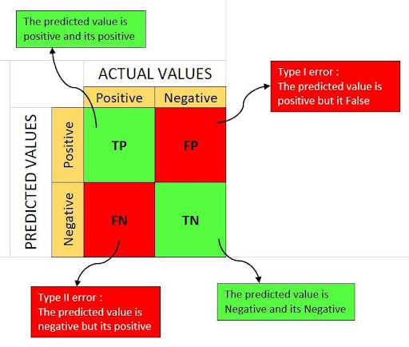
Confusion Matrix
Useful machine learning tool
Data for the metrics
Notes:
Confusion matrix is showing the amount of error and evaluating the behavior and understanding the effectiveness of a binary or categorical classifier

Slide 14
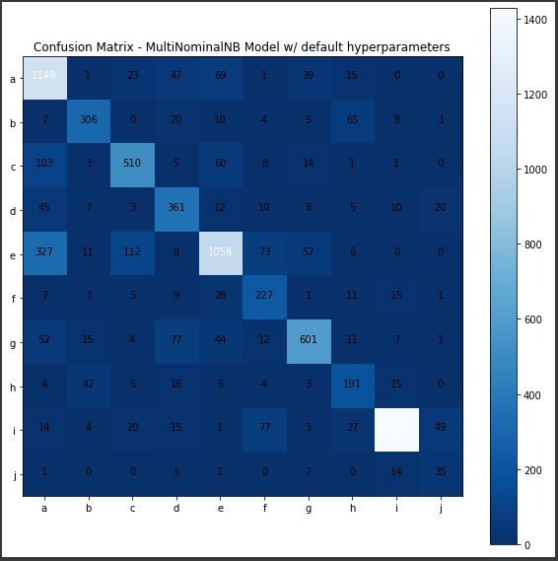
Heat Maps
Notes:
Heat map is visualization of data
labels on the heat maps
explain the heat maps interpretation more

Slide 15
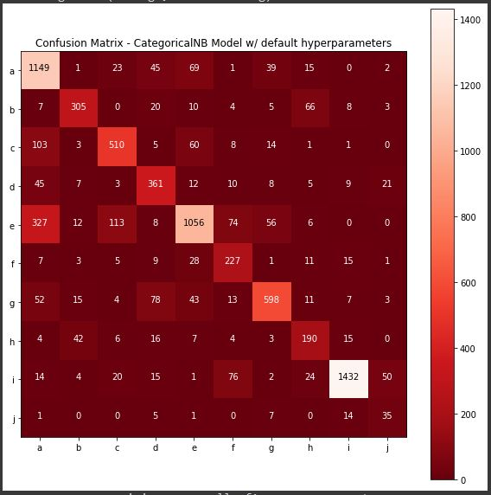
Heat Maps
Notes:
Heat map is visualization of data
labels on the heat maps
explain the heat maps interpretation more

Slide 16
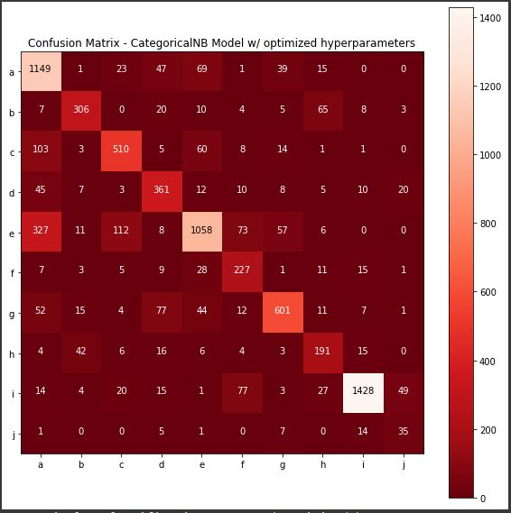
Heat Maps
Notes:
Heat map is visualization of data
labels on the heat maps
explain the heat maps interpretation more

Slide 17

Phase 3
Classification Report
Receiver Operating Characteristic Curve (ROC)

Slide 18
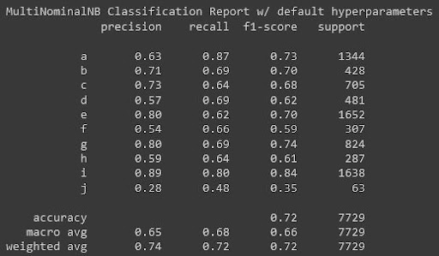
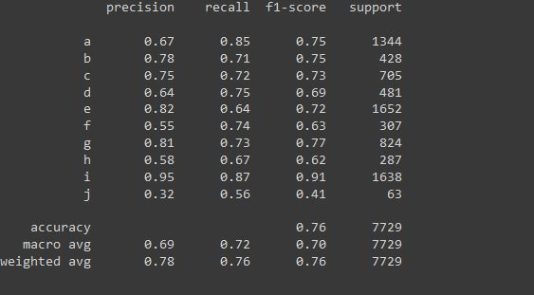
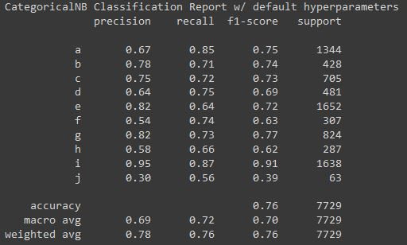
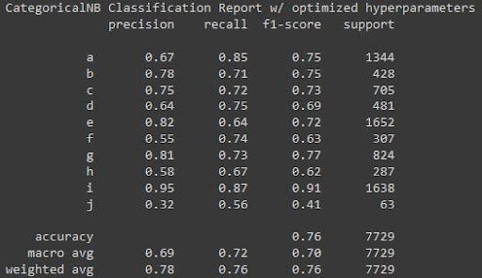
Classification Report
Shows metrics of each letter and the total average
Notes:
add print to code so we can have the name in the screenshot

Slide 19
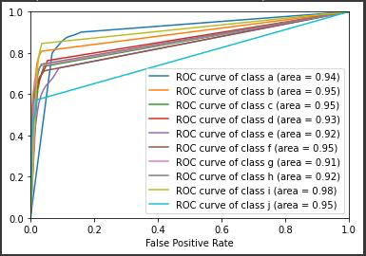
ROC Curve
Graph showing performance of classification model
Plots two parameters
True positive rate
False positive rate

Slide 20
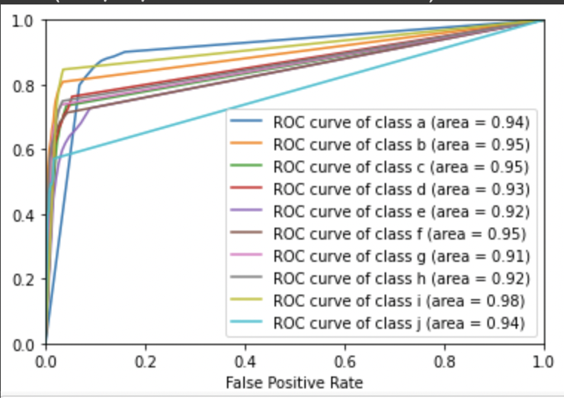
ROC Curve
MultinomialNB Model
CategoricalNB Model

Slide 21
Changes for the future
Having more letters to train the model
Using different languages
Raise the overall accuracy of our model
More pixels/More detailed images

Slide 22
Conclusion
We successfully trained and tuned our model to achieve a maximum f1 score of 91 percent and a minimum f1 score of 41 percent. This model can go on to identify even more letters and possibly other languages if given the data.

Slide 23

Questions?

Slide 24
Acknowledgements
We would like to take this opportunity to thank
NACME and Michele Lezama
Google
And Morgan State University
As well as
Dr. Poindexter
Dr. Babatunde Olubando
Kayla Thames

